Slide 1

Presented by- Prem Amal Jash Shah
Exploratory Data Analysis of Lifestyle Factors and Sleep Patterns

Slide 2
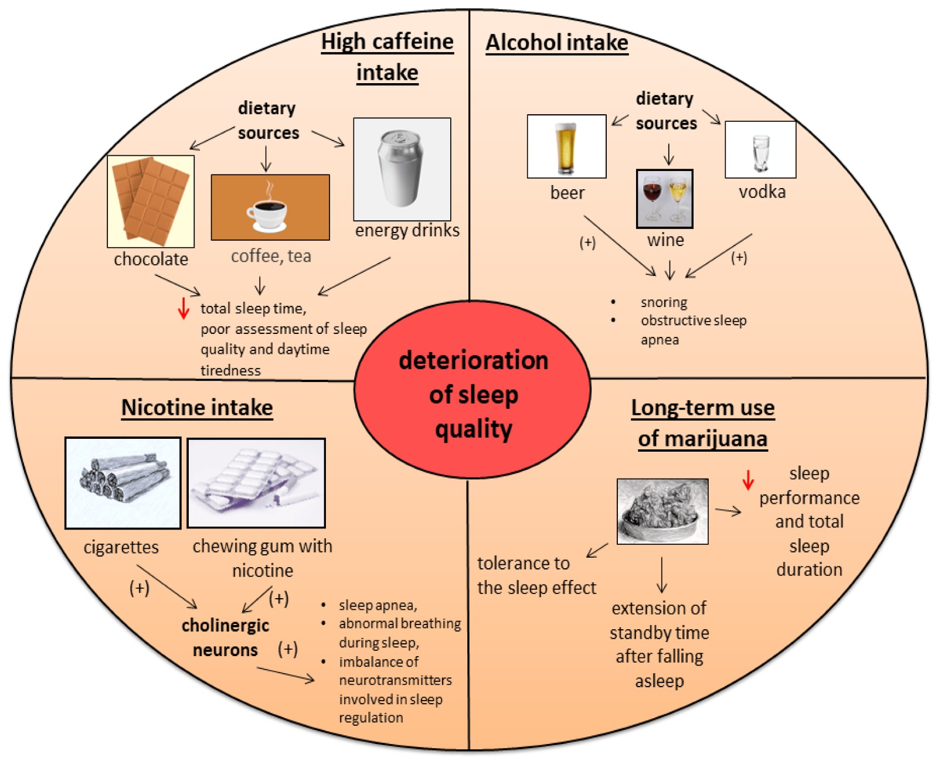
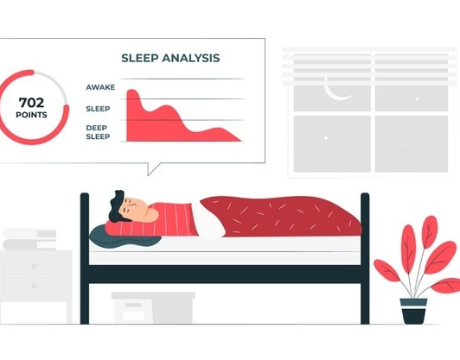
Objectives/Research Question
Importance of Sleep
Facilitates Impacts metabolism, immunity, and brain function.
repair and restoration.
Reduces the risk of diseases.
Research Question
Detailed investigation and exploration of features (exercise, bedtime routines, caffeine intake, smoking habits, and other lifestyle decisions )
Identify the major factors (lifestyle choices) impacting the sleep cycle/ sleep efficiency of a person.
Explore Sleep Duration vs Sleep Efficiency
Goals
Advance knowledge of sleep health
Identify and encourage good sleep habits to improve well being

Slide 3
Dataset Description
Variable/Features | Units
Age | Years
Gender | Biological State
Bedtime | Time in 24hours format
Wakeup Time | Time in 24hours format
Sleep Duration | Hours
Sleep efficiency | Fraction
REM sleep percentage | Percentage
Deep sleep percentage | Percentage
Light sleep percentage | Percentage
Awakenings | Count
Caffeine consumption | Milligrams per day
Alcohol consumption | Oz
Smoking status | Binary (Yes/No)
Exercise frequency | Count per week
The dataset includes information about the sleeping habits of a cohort of people.
Originated from a study conducted in Morocco by AI engineering students from ENSIAS. Participants recruited people from the local community to collect data and utilized a mix of self-reported surveys, actigraphy, and polysomnography for data collection.
Dataset Source : Kaggle.com
Dataset Shape : 452 records with 15 features

Slide 4
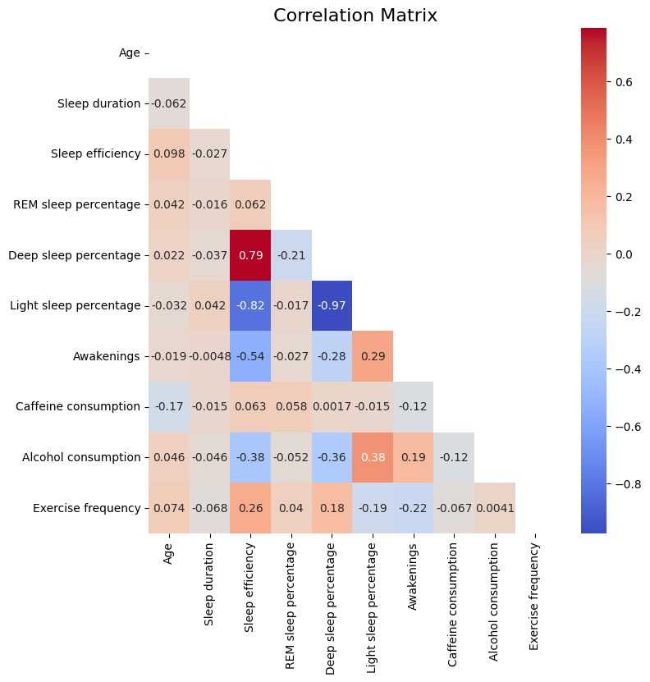
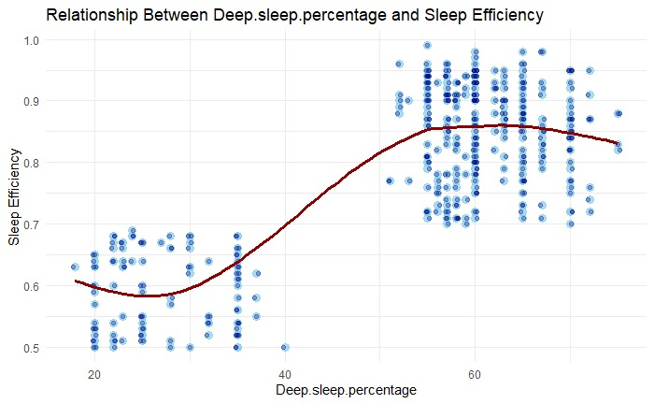
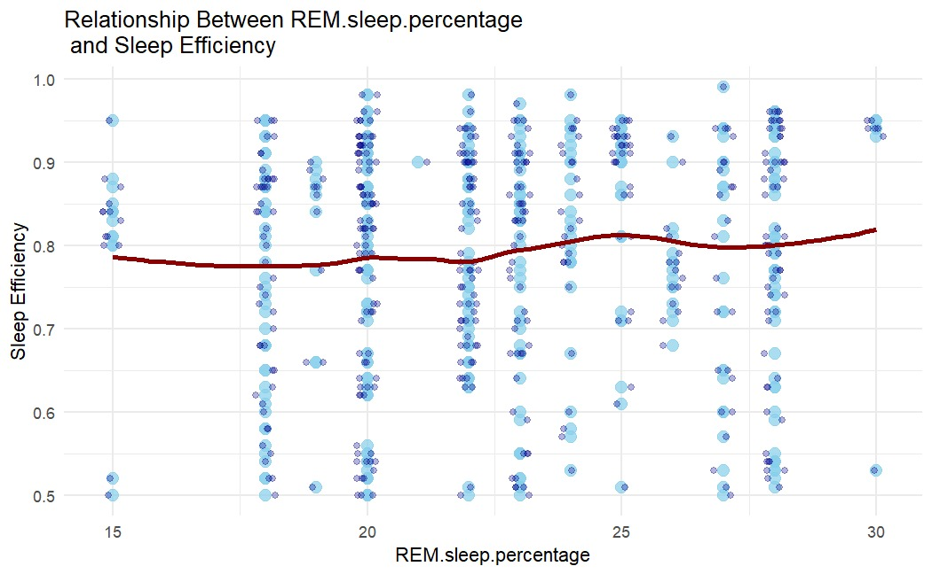
Relationships with Sleep Efficiency
Notes:
Correlation Matrix to show which points are dependent Deep Sleep, Light Sleep, Awakenings, Alcohol consumption, Exercise Frequency
We assumed that Sleep Efficiency will be dependent on Rem Sleep but indeed it is dependent on deep sleep percentage
More you have deep sleep better is the sleep efficiency

Slide 5
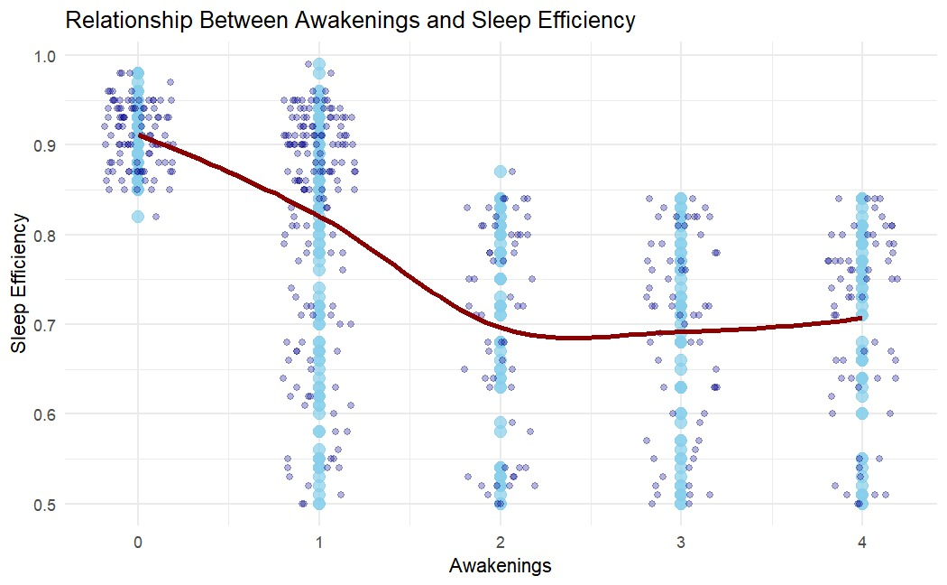
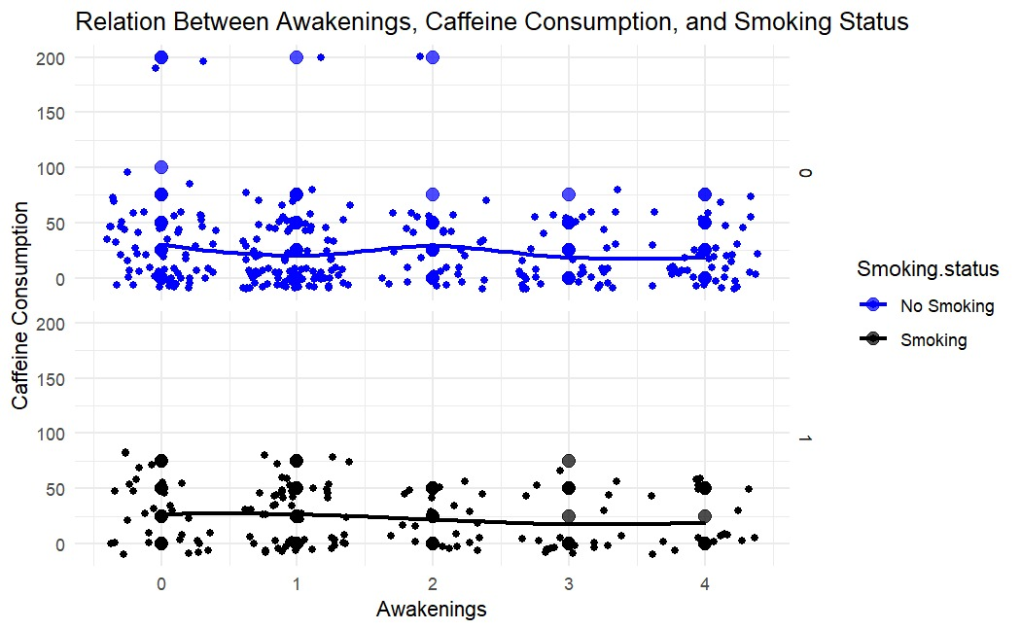
Influence of Awakenings
Awakenings depends on?
Awakenings exhibit a pronounced influence on sleep efficiency .The average sleep efficiency tends to be higher when there are less awakenings.
Awakenings do not exhibit the anticipated dependency on caffeine consumption in our data. This is because we lack information about the timing of caffeine intake.

Slide 6
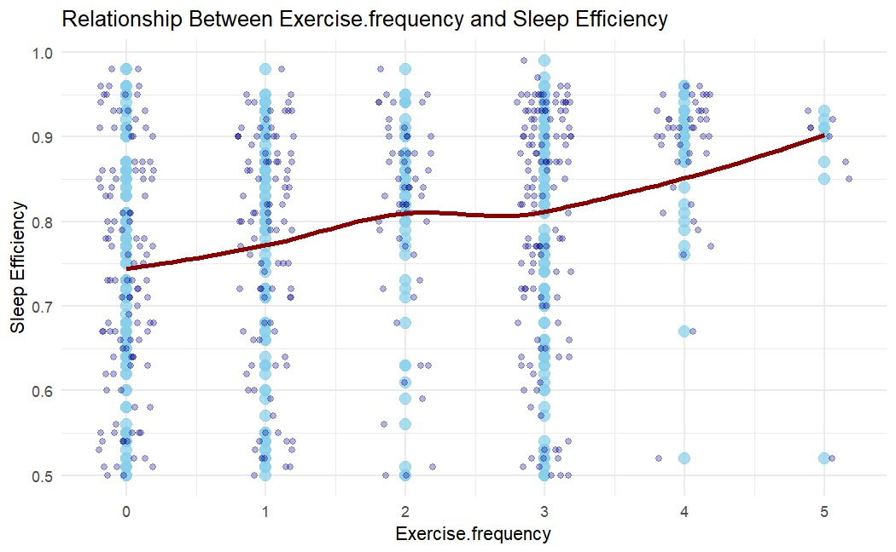
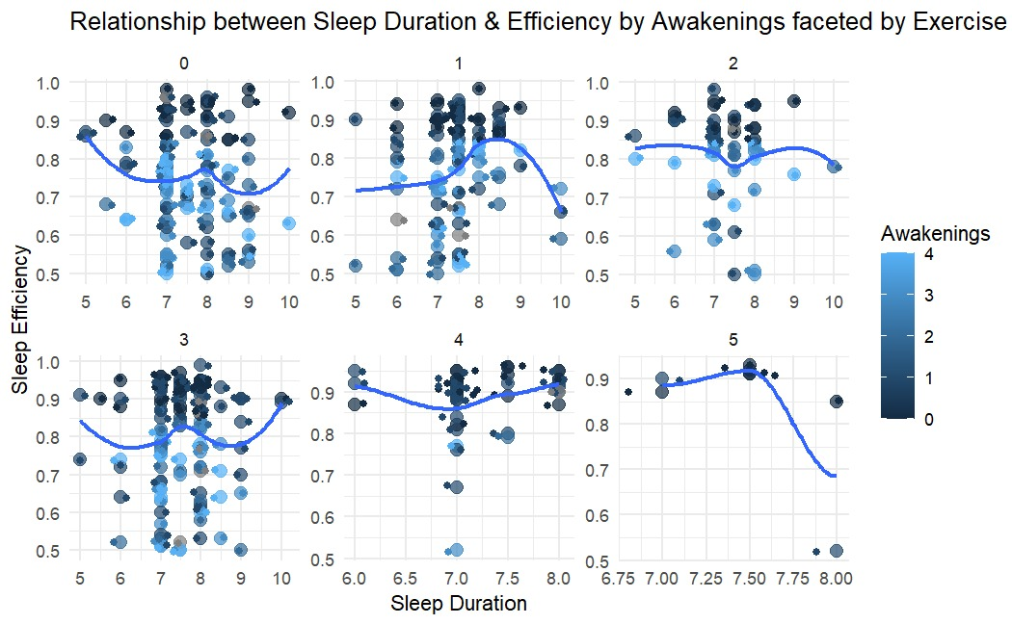
Exercise vs Awakenings
Exercise is the key
Upon observation, it becomes evident that a higher frequency of exercise correlates positively with improved sleep efficiency.

Slide 7
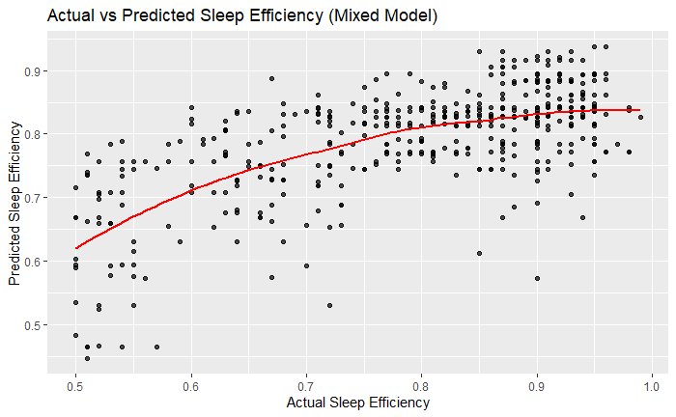
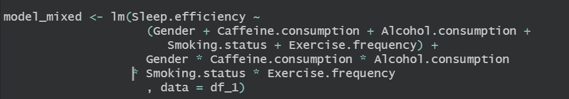
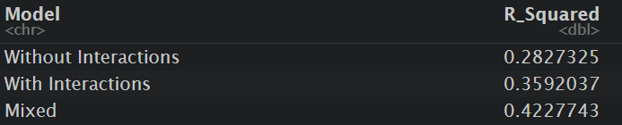
Linear Model
Modelling Choices:
Rather than modeling the data based on sleep statistics, we attempted to model it considering lifestyle choices like smoking, caffeine consumption, alcohol, and exercise frequency.

Slide 8
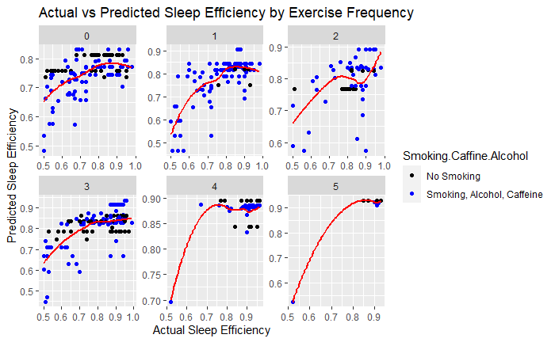
Alcohol, Smoking, Caffeine vs Exercise Residual plot
Given the lifestyle parameters, model is not able to capture all the trends and relationship efficiently
For exercise frequency 4 model is able to capture the trends considering the lifestyle choices.
To improve the model we can use the interactions of lifestyle factors with sleep statistics to get a better R squared.

Slide 9
Conclusion and next steps
Healthier Lifestyle choices boosts up the sleep efficiency.
Exercise and awakenings play a major role in deep sleep which in turn helps to improve sleep efficiency.
Smoking, Caffeine consumption, alcohol do not directly affect sleep efficiency. (May be due to lack of important information like caffeine consumption time, smoking is the binary variable, so the time of smoking is unknown and same goes for alcohol)
As part of next steps, fit a logistic model to predict sleep efficiency (Yes or No) based on threshold value.

